Slide 1
Reporting violence against women
Lesson three: Communicating the results

Slide 2
Taking care of yourself and others
Violence against women and their children is common
We can be almost certain that the issues we are raising will be directly relevant to some of the people in this room.
Because of this, some people might find the content confronting or triggering
If you need to take a break, please do so

Slide 3
Taking care of yourself and others
While we acknowledge and support you, this is not the place to reveal sensitive personal information
If you want to seek more help, please see the resources listed at the end of this presentation
Even if none of this applies to you, please be mindful about others, and take care to discuss and debate the issues with respect and consideration for your classmates

Slide 4
Everyone can find this content challenging
Most men are not violent. If you are not a violent man, we are not talking about you when we discuss perpetrators of violence
Family violence is not a women’s issue. It is an important social issue, and men and women can and should play a positive role to prevent it

Slide 5
Communicating the results
Journalism has two sides: finding things out and communicating the results.
In this lesson we are concentrating on the second aspect of that job.
Two parts to this lecture:
  Legal restrictions
  Framing the story

Slide 6
How media report family violence
The research tells us that there are a number of key issues in how the media has portrayed violence against women and family violence
Violence that is not blatantly physical is less likely to be reported
The social context for violence against women is often neglected
Stories can be sensationalised through the language used
Journalism can perpetuate myths and misrepresentation
Journalism can directly and indirectly shift blame from male perpetrators to female victims
Journalists over-rely on law enforcement as the expert ‘voices’
Notes:
ANROWS, (2015) ‘Media representations of violence against women and their children: State of knowledge paper’, Landscapes, Issue 15.
ANROWS, (2016) ‘Media representations of violence against women and their children: Final Report’, Horizons, Issue 3.

Slide 7
Reporting guidelines
A number of guidelines have been developed internationally to guide reporting.
Common themes:
report the social context in which male perpetrated violence against women occurs
use correct language and terminology
avoid blaming the victim
avoid offering excuses for men’s violence
consider how source selection shapes the story
provide women with information on where to seek help
Notes:
ANROWS, (2015) ‘Media representations of violence against women and their children: State of knowledge paper’, Landscapes, 15, pp.28-30.
APC, (2016), ‘Advisory Guideline on Family and Domestic Violence Reporting’
DART Center for Journalism & Trauma, (2012), ‘Resources: Reporting on Intimate Partner Violence’
OurWatch, (2014), ‘Reporting on Domestic Violence’

Slide 8
1
Legal restrictions

Slide 9
Contempt of court
Once a person has been charged with a crime, the media should not:
Suggest that the person is guilty
Suggest that the person is innocent
Report prior convictions
Report that the person has previously been violent
Cast doubt on the credibility of witnesses before courts
In most cases, stick to the bare facts of the case and what is said in open court
If you’re unsure, get legal advice

Slide 10
Contempt of court
Victims of sex crimes appearing before the court cannot be identified without their permission
Minors cannot be identified, nor can wards of the state
  This means minors at the time of the incident, even if they are adults by the time they appear in court. The age varies by jurisdiction.
Nobody appearing before Family Court can be identified (including witnesses)
Be careful about identification by association: “John Smith, 49, of Clayfield, is charged with the rape of his then-partner.”
  Clearly identifies both Smith and his alleged victim

Slide 11
Suppression orders
Courts may issue suppression orders that limit the media’s ability to report family violence
In most states, there are restrictions on reporting the existence of an intervention order in family violence cases
It is not contempt to publish details of help lines in court and crime stories that deal with family violence
If you’re unsure, get legal advice

Slide 12
Defamation
Make sure you can prove allegations published – the most importance defence is truth
Remember that courts have a stricter standard for evidence than journalists
If allegations are made in court or parliament, you may be able to publish with a fair report defence
Remember: quoting somebody else doesn’t protect you from defamation action. You are liable for what you publish
If you’re unsure, get legal advice

Slide 13
If you’re unsure,
get legal advice

Slide 14
2
Framing the story

Slide 15
Framing the story
Think about a picture frame
It contains a picture, defines its edges and draws your attention to certain elements
The framing of a story influences how a reader sees it
If the media reports family violence as individual incidents without making it clear this is a pervasive social issue, that also affects how readers understand it

Slide 16
Framing the story
Things that influence the frame in which you put your story
Sources
The questions you ask
The language you use

Slide 17
Framing the story
We rarely expect the victims of crime to explain why the perpetrator acted as they did – yet the research tells us that in cases of family violence, reporters often seem to want to ask “why” questions.
For example, did she provoke him, was it a “volatile relationship”, was she drunk, was he under pressure?
Remember the perpetrator is responsible for the crime
Notes:
ANROWs, (2015) ‘Media representations of violence against women and their children: State of knowledge paper’, Landscapes, 15, p. 16

Slide 18
Framing the story
Language
Rape or assault is not “sex” or an “argument”
  “Child sex” is incorrect
A pattern of abuse is not an “affair” or a “volatile relationship”
Child abuse is not “discipline”
A victim is also a survivor (except when they do not survive), and may prefer that term
Name the issue – violence, abuse, assault by her husband, or whatever is relevant (subject to legal restrictions)

Slide 19
Women who experience multiple forms of discrimination and disadvantage

Slide 20
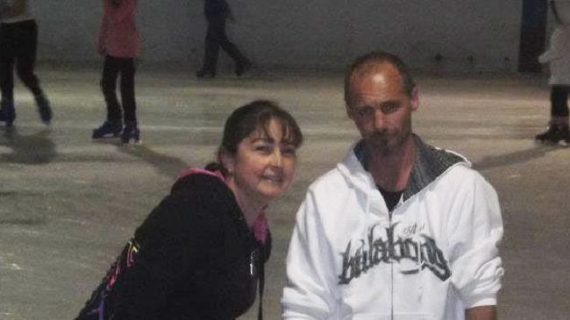
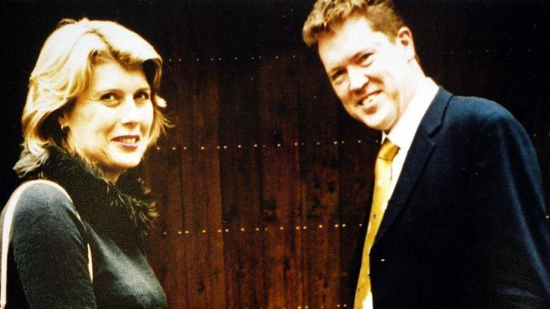
The McDermott case

Slide 21
The McDermott case frame
He stabbed her six times
He stalked her and chased her
He rugby tackled her
He told the kids and others that he would kill her
He was ferocious

Slide 22
The McDermott case reaction
Both men and women thought McDermott was a violent and possessive man. They sympathised with Warzywoda
A few men sought to make excuses for McDermott, but all others wrote him off
His crime was seen as particularly brutal, pre-meditated and the result of anger management issues
Several people noted that Warzywoda is almost invisible in the article. They saw her as justifiably frightened of her former partner

Slide 23
The Ramage case

Slide 24
The Ramage case frame
She taunted him
She provoked him
He tried to win her back (or stalked her?)
She lied to him
He was “under attack”

Slide 25
The Ramage case reaction
Men thought James Ramage was “understandable” and “broken-hearted”
Men thought Julie Ramage had treated him cruelly
They did not excuse him killing her, but said they understood how “had been driven” to do so
Women thought James Ramage was controlling and possessive
They saw Julie as the victim of an obsessive husband and were outraged at efforts to paint James as the victim

Slide 26
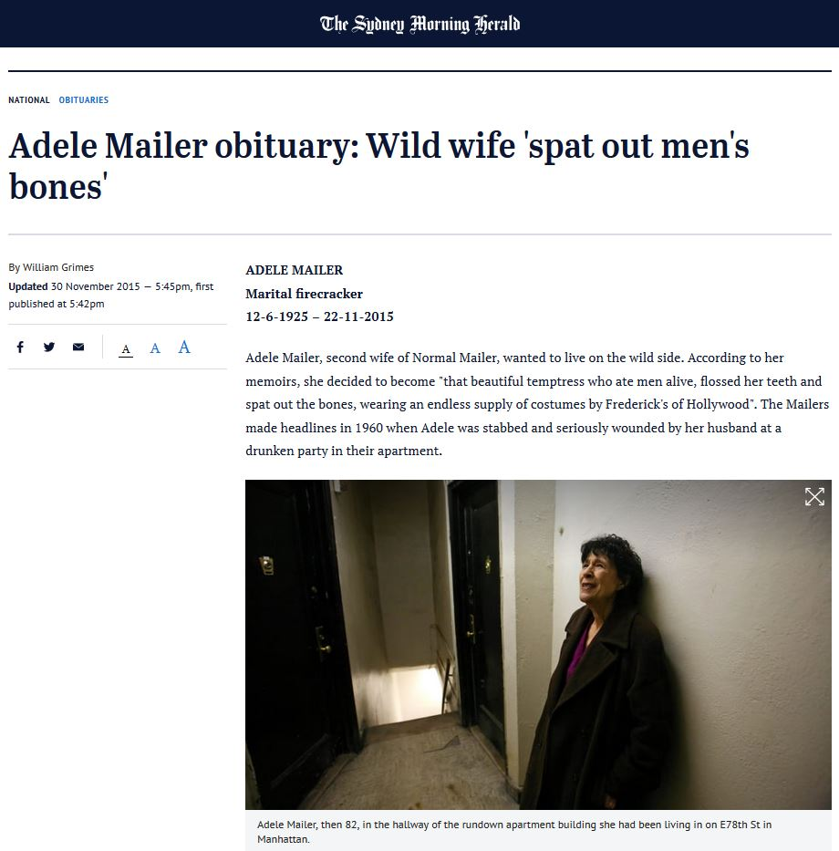
Adele Mailer: Sydney Morning Herald obituary
Notes:
https://www.smh.com.au/national/wild-wife-spat-out-mens-bones-20151130-glbrtp.html

Slide 27
SMH obituary
Sources
Adele Mailer’s memoirs
Court records
Norman Mailer’s evidence in court
Norman Mailer interview in New York Times
Norman Mailer interview with PBS

Slide 28
SMH obituary
Language
Headline: “Wild wife 'spat out men's bones‘”
Description of victim: “that beautiful temptress who ate men alive, flossed her teeth and spat out the bones”.
Description of relationship: “marked by heavy drinking and ancillary love affairs on both sides, was stormy.”
Responsibility for abuse:
“Some guests recalled that the point of no return came when she told her husband that he was not as good as Dostoyevsky”
Perpetrator says: “It is important for me not to be sent to a mental hospital, because my work in the future will be considered that of a disordered mind. My pride is that I can explore areas of experience that other men are afraid of. I insist I am sane.”
Perpetrator says: “A decade's anger made me do it. After that, I felt better.”

Slide 29
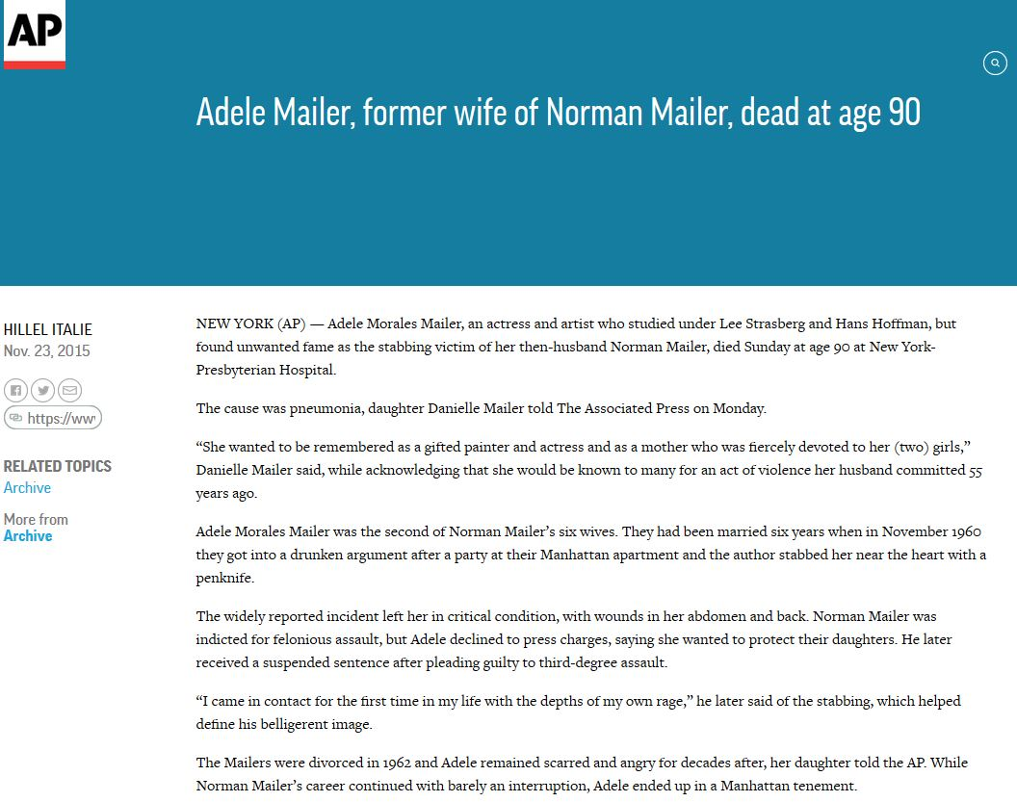
Adele Mailer: Associated Press obituary
Notes:
https://www.apnews.com/aa82a380ab8e4d66a5bd3179521642b5

Slide 30
Associated Press obituary
Sources
Adele Mailer’s daughter
Court records
Norman Mailer interview
Adele Mailer interview with New York Times
Adele Mailer’s memoirs (different quotes)

Slide 31
Associated Press obituary
Framing
Victim described in terms of her professional roles, not only as perpetrator’s wife
Impact on victim is emphasised. Lack of impact on perpetrator’s career noted
Quote from memoirs emphasise impact of crime, rather than implying victim is to blame or is a bad woman asking for it
Survivor strength emphasised, with Adele Mailer’s continuing achievements

Slide 32

A journalist’s job: use judgement
http://www.abc.net.au/mediawatch/transcripts/s4846264.htm
Notes:
http://www.abc.net.au/mediawatch/transcripts/s4846264.htm

Slide 33
Alternatives to “good bloke” frame
“Friends and family saw no sign that the family was troubled – as is often the case with family violence.”
“As is so often the case, the troubles in the family were hidden from many of those closest to them.”
“Sadly, family members did not reach out for help to those closest to them, and their problems remained hidden.”

Slide 34
Language
Be conscious in your choice of language and reconsider common phrases
Headline conventions can often lead to misrepresentations of violence – perpetrators, crimes and victims are sometimes obscured
Be careful not to provide excuses for violence or shift blame onto the victim

Slide 35
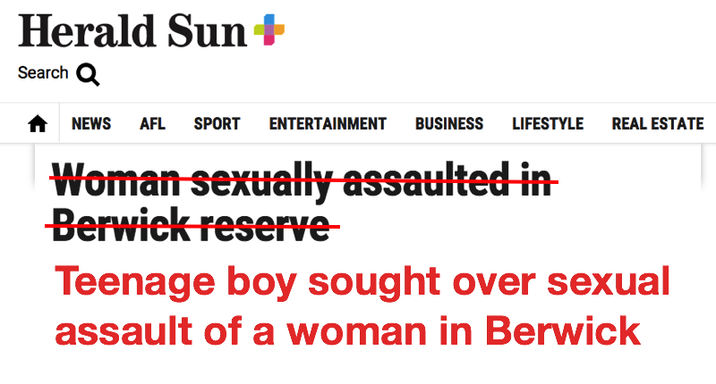
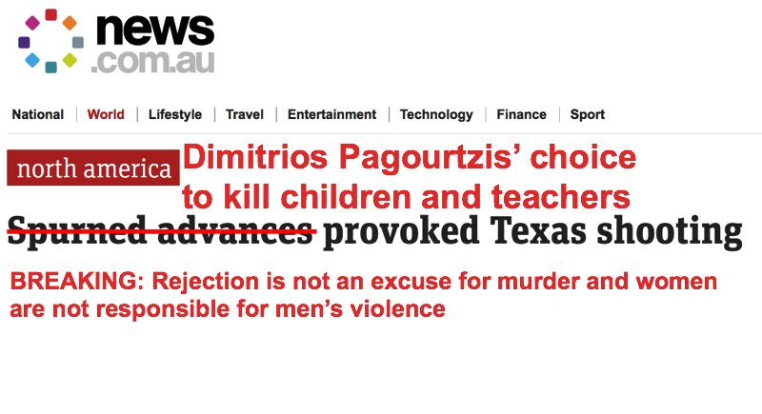
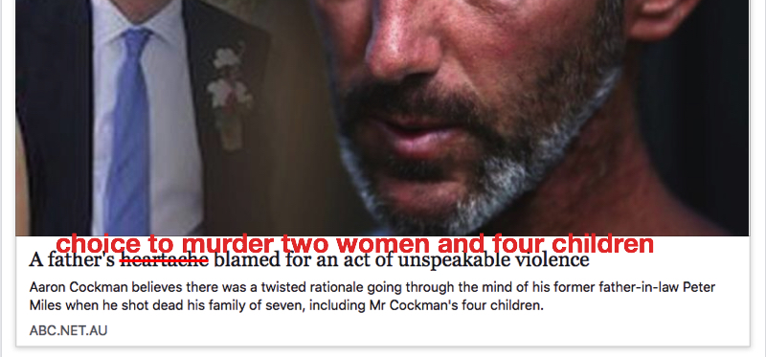
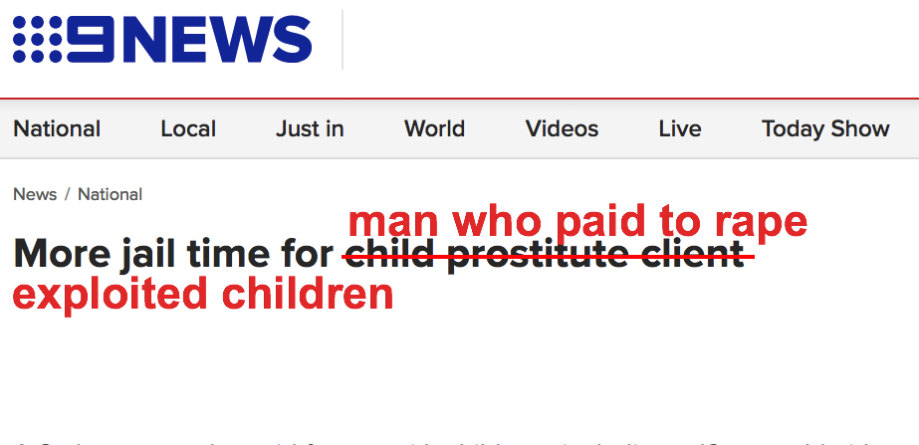
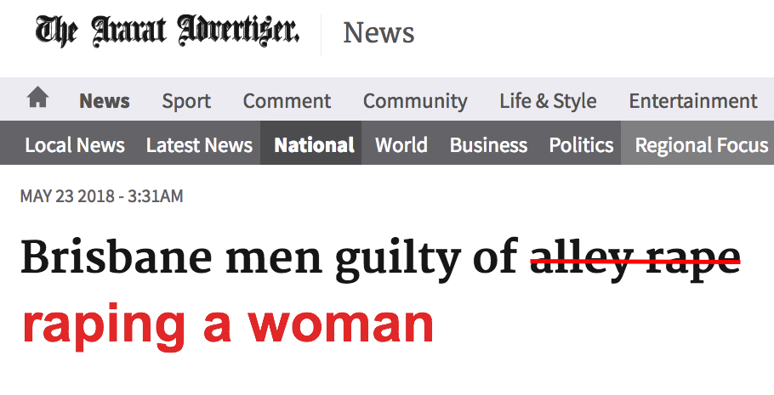
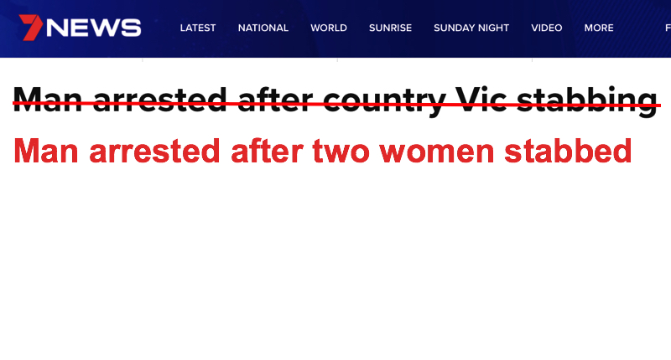
Notes:
Journalist Jane Gilmore’s #FixedIt project

Slide 36
Help lines
On any story dealing with family violence, be sure to include information for people who may need help
Begin with local services and, where appropriate, those that assist people in specific communities.
Always end with the national help line:
  If you or someone you know is impacted by sexual assault or family violence, call 1800RESPECT on 1800 737 732
  or visit www.1800RESPECT.org.au
  If you or someone you know is perpetrating violent behaviour, ring Men's Referral Service 1300 766 491
  In an emergency, call 000

Slide 37
Conclusion
Violence against women is both deeply personal and an important public issue. Reporting well can be complicated
Subject to legal restrictions, name the crime as family violence
Critically review your words. Who is portrayed as having responsibility for the crime?
Have you given the social context?
Remember that crimes are often the high point of abuse previously hidden. Be skeptical of descriptions of perpetrators as having “snapped” or as “good blokes”
Are you describing the crime or sensationalising it?
Have you given sources of more information and support?

Slide 38


If you or someone you know needs support:

Slide 39
Resources and Help
Services for Journalists and Students
DART Self-care resources available at http://dartcenter.org/topic/self-care
Please seek out your University Counselling Services
Other Services
These organisations offer 24/7 telephone support and counselling services, and online chat, for specific groups and for people in specific situations.
1800 RESPECT
  The national sexual assault, domestic and family violence counselling service. 24/7 phone and online services.
  1800 737 732
KIDS HELPLINE
  Kids Helpline is a counselling service for Australian children and young people aged between 5 and 25 years. 24/7 phone and online services
  1800 55 1800
MENS LINE
  Professional support and information service for Australian men. 24/6 phone and online services.
  1300 78 99 78
MEN’S REFERRAL SERVICE (MRS)
  MRS provides anonymous and confidential telephone counselling, information and referrals to men to help them take action to stop using violence and controlling behaviour.
  1300 766 491
NAPCAN
  Go to the Urgent Help section of the National Association for Prevention of Child Abuse and Neglect (NAPCAN) website for contact details of agencies which assist with reporting child abuse and neglect.

